Slide 1
Advisory Report 5
Shrey Agrawal Jiayi Chen
Hong Doan
May 9, 2023

Slide 2

Agenda
Business Understanding Revisit
Goals Statements & Our Work
Reflections

Slide 3
Business Understanding
“Build A Better Grinnell” is a community-based initiative aimed at improving the quality of life in Grinnell, Iowa.
The goal is gather data from the focus population (Grinnell residents), collect innovation from the base and have a shared understanding of strengths, visions, and priorities.

Slide 4
Business Understanding
The clients provided us with Revised Organization and Frequency Counts which is a frequency count for the six needs questions
If you do not currently live here, what changes in the community might cause you to move to Grinnell?
Have there been things that have made you consider leaving Grinnell? What were they?
What things have frustrated you about living in Grinnell?
What things do you think Grinnell is missing – that would benefit you personally if it had?
If funds were unlimited, what changes would you make to improve Grinnell?
If you do not currently live here, what changes in the community would make you more likely to move to Grinnell?
To identify an issue, the frequency count should pass the 1% respondents cut-off point. We focus on those need that client's prioritized the most.

Slide 5
Goals Statements - What to Expect
Goal 1: Data Cleaning
Goal 2: Create a keyword list and filter out respondents using these keywords
Goal 3: Subset these respondents, and then see what they are saying by clustering, word frequency, words before after, sentiment average, etc.
Goal 4: Repeat the analysis with the most respondents counts that client has identified

Slide 6
Goal 1:
Data Cleaning
Conduct Data Cleaning with New Dataset the clients gave us.
Previous Dataset contains form responses, miscellaneous partial responses, transcribed paper responses, and Grinnell College student responses
New Dataset now contains form responses and Grinnell College student responses based on the clients’ needs
509 form responses + 34 Grinnell Student Responses = 543 Respondents

Slide 7
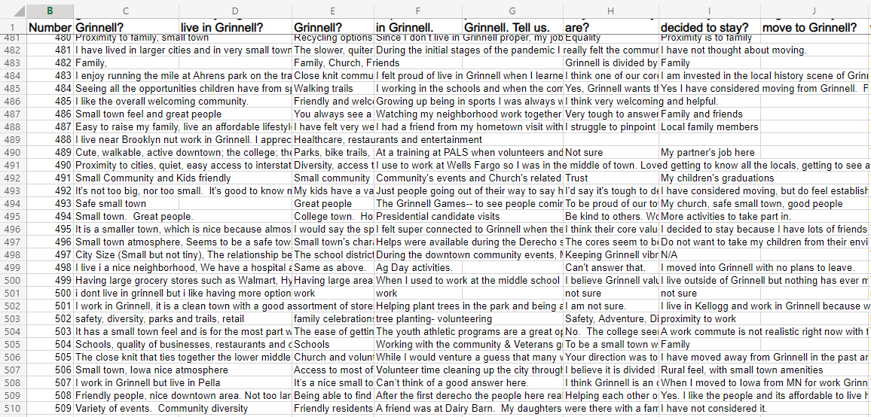
367 form responses → 509 form responses

Slide 8
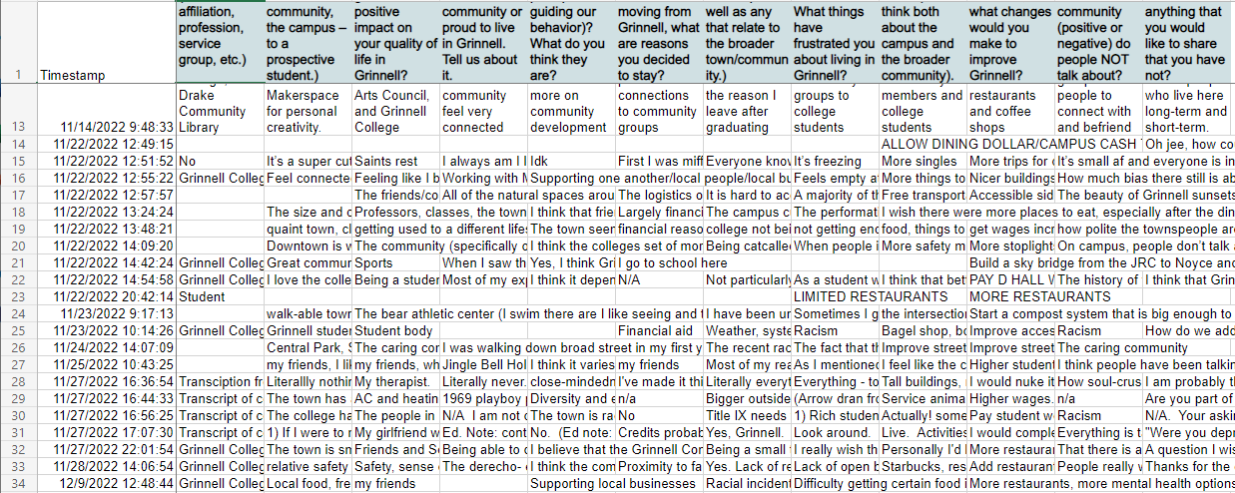
33 Student Responses → 34 Grinnell College Students Response

Slide 9
Goal #2
Create a keyword list and filter out respondents using these keywords
Goal #2.1 Create a keyword list based on the Issues that have been identified based on the six needs questions
If you do not currently live here, what changes in the community might cause you to move to Grinnell?
Have there been things that have made you consider leaving Grinnell? What were they?
What things have frustrated you about living in Grinnell?
What things do you think Grinnell is missing – that would benefit you personally if it had?
If funds were unlimited, what changes would you make to improve Grinnell?
If you do not currently live here, what changes in the community would make you more likely to move to Grinnell?

Slide 10
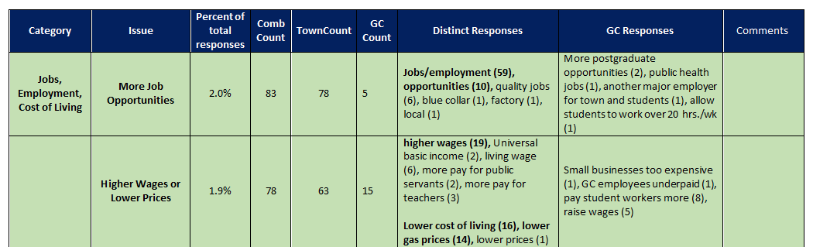
35 Issues (marked Green Issues): | Keyword Lists:
More Job Opportunities | employ, employer, employment, career, occupation, work, profession, job, recruit, recruitment, hiring, employment opportunity, part-time job, full-time job, temporary job, remote work
Higher Wages or Lower Prices | Wages, living wage, inflation, salaries, prices, cost of living, living expenses, income, social welfare

Slide 11
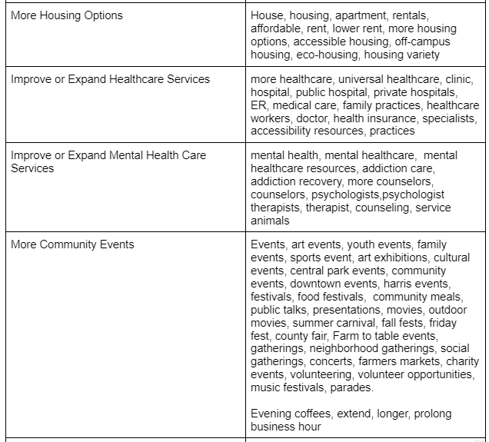
Goal #2.2 Filter out respondents based on the issues
We created 35 keyword lists and established 35 subsets based on the issues the clients provided.

Slide 12
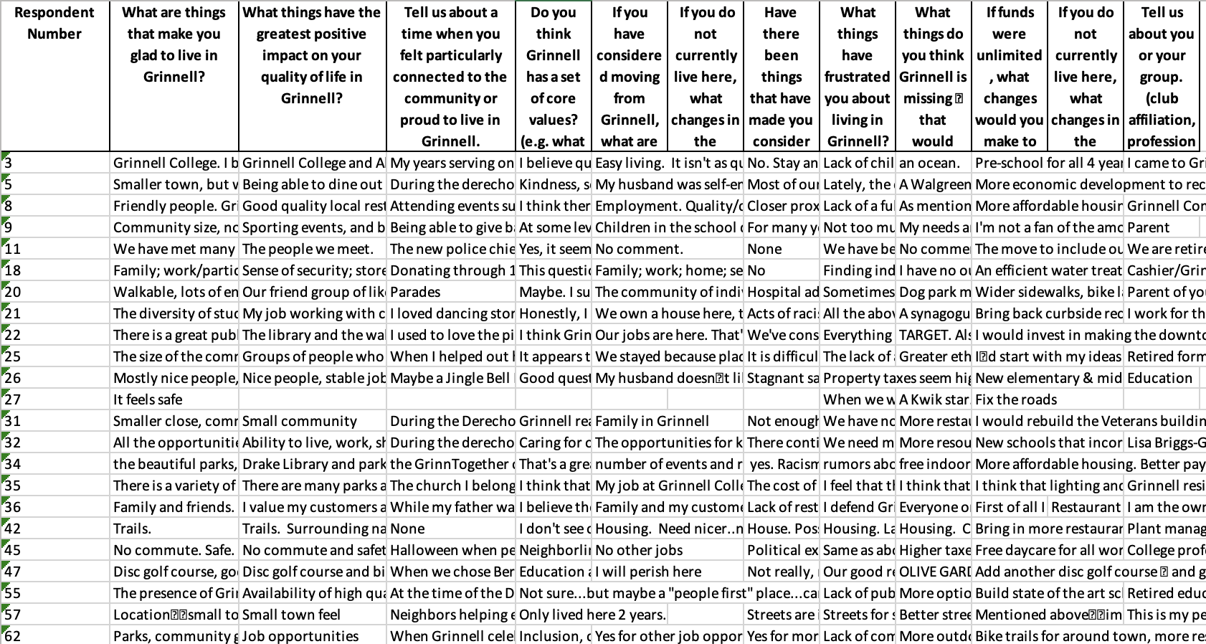
Subset for More Job Opportunities

Slide 13
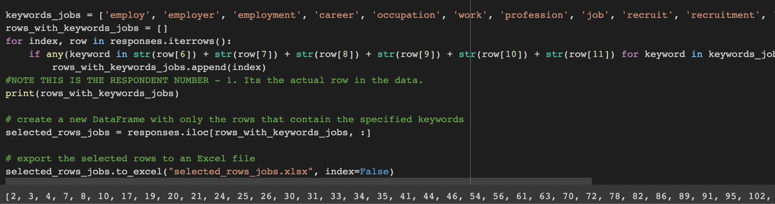

Slide 14
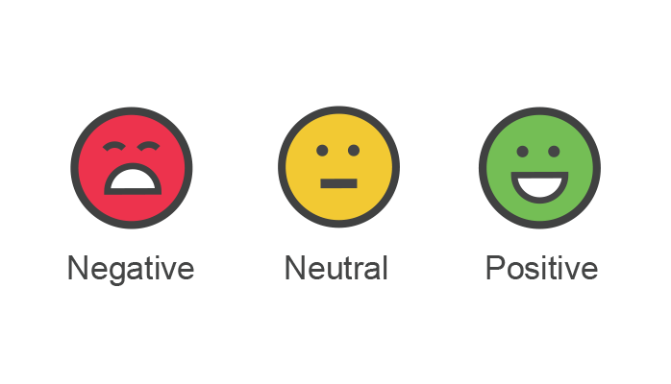
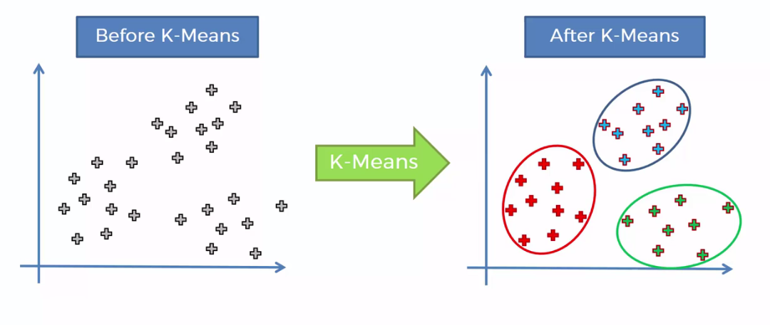
Goal #3
Further Analysis
Sentimental Analysis
Word Counts
K-means Clustering

Slide 15
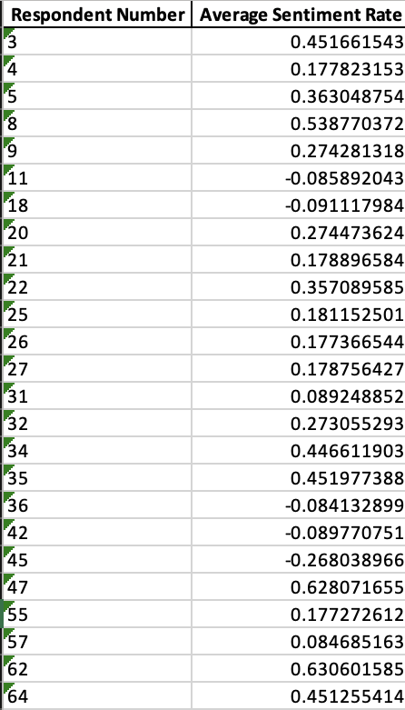
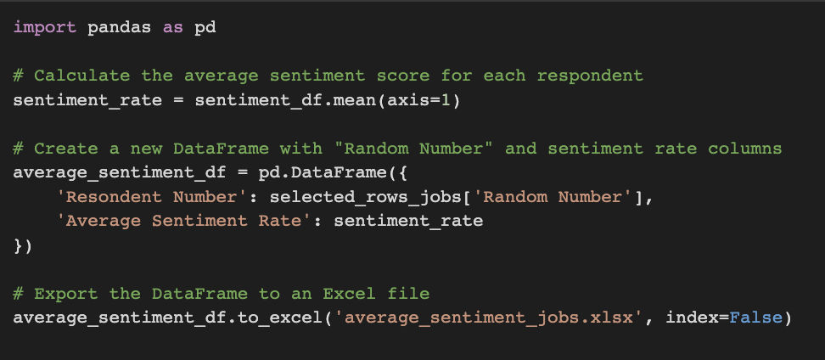
Sentimental Analysis - Jobs

Slide 16
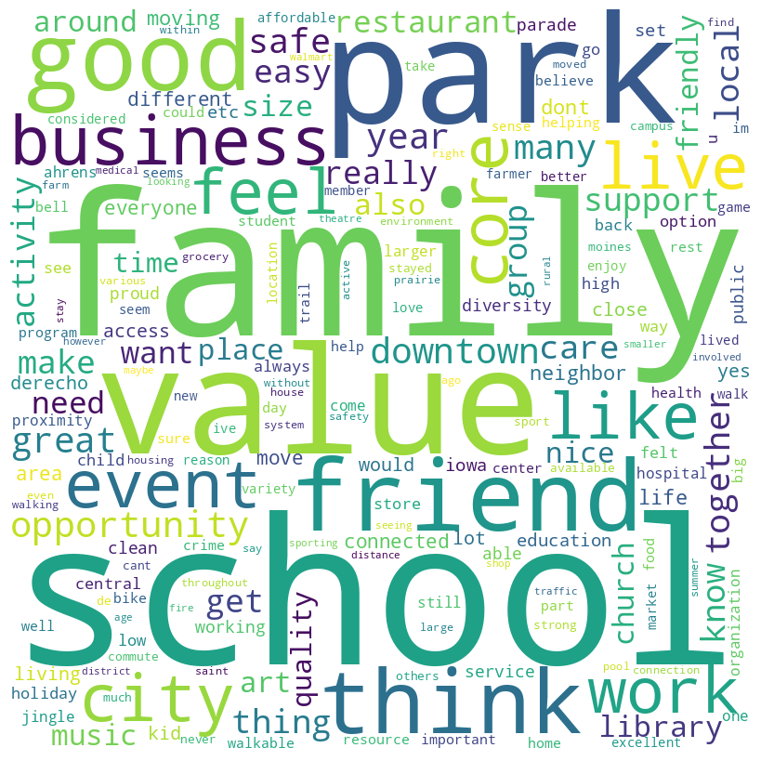
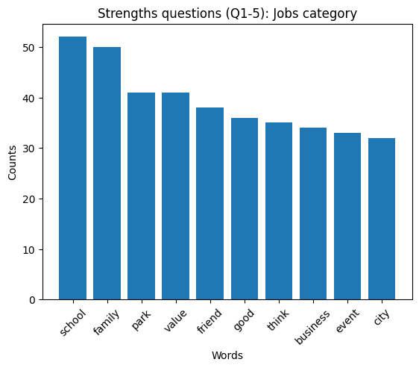
Word Counts
Jobs category

Slide 17
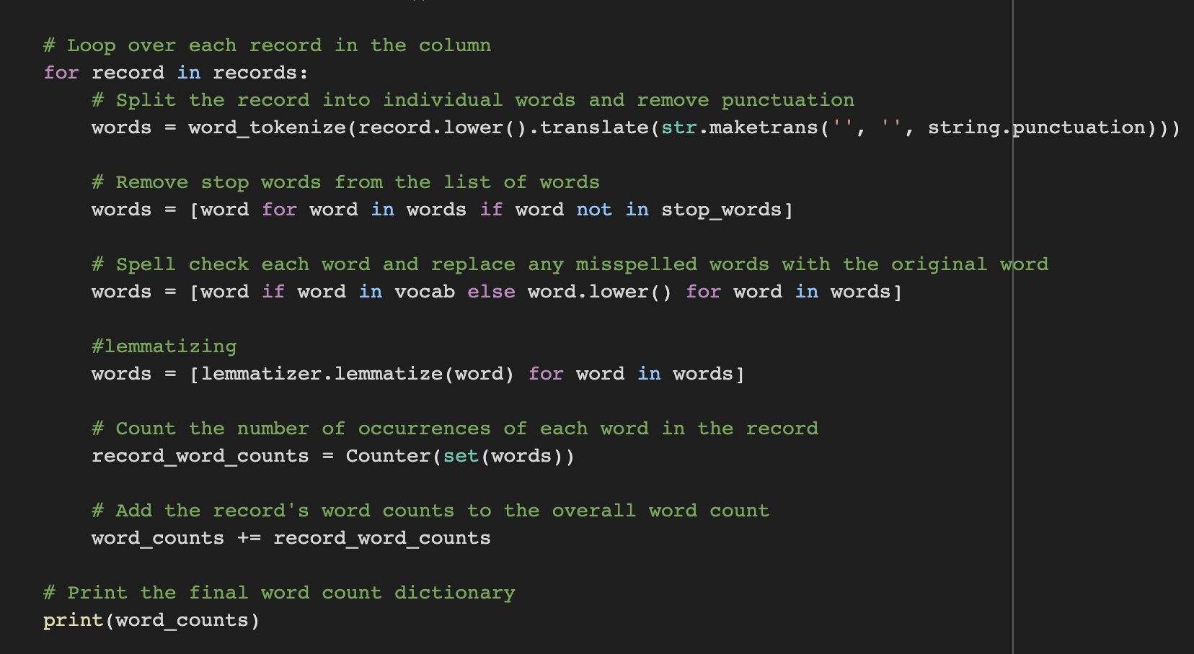

Slide 18
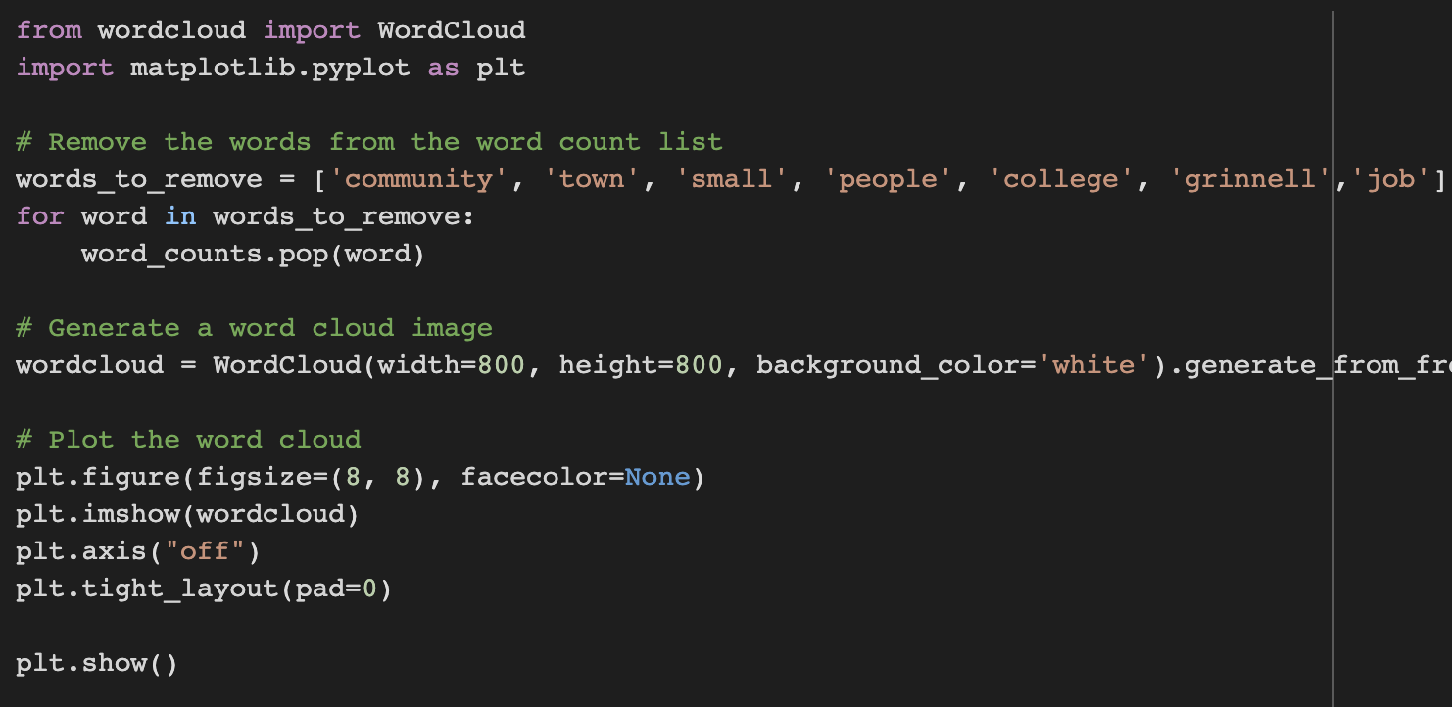
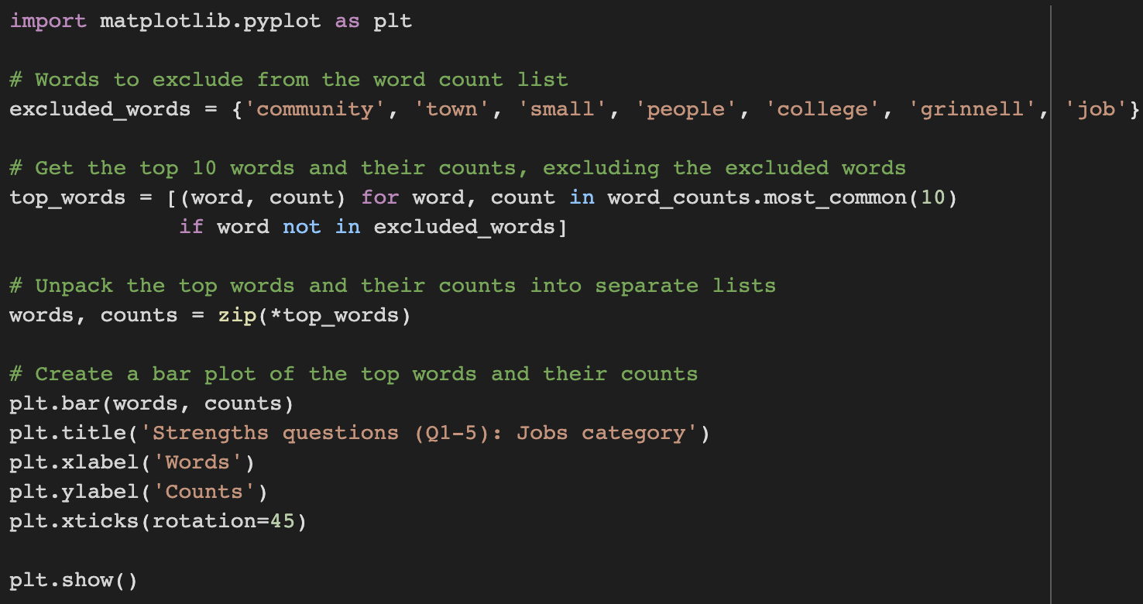

Slide 19
K-means Analysis Revisit
K-means clustering: partitions data points into K clusters based on similarity in feature space and minimizes sum of squared distances to cluster centers.

Slide 20
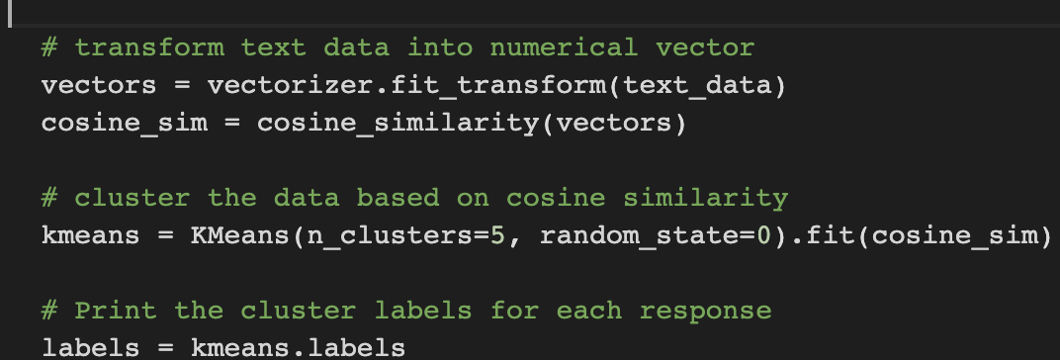

Slide 21
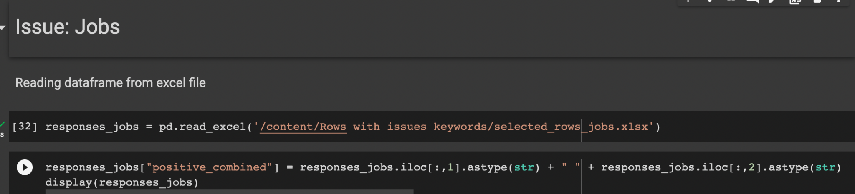
K-mean clustering: Jobs

Slide 22
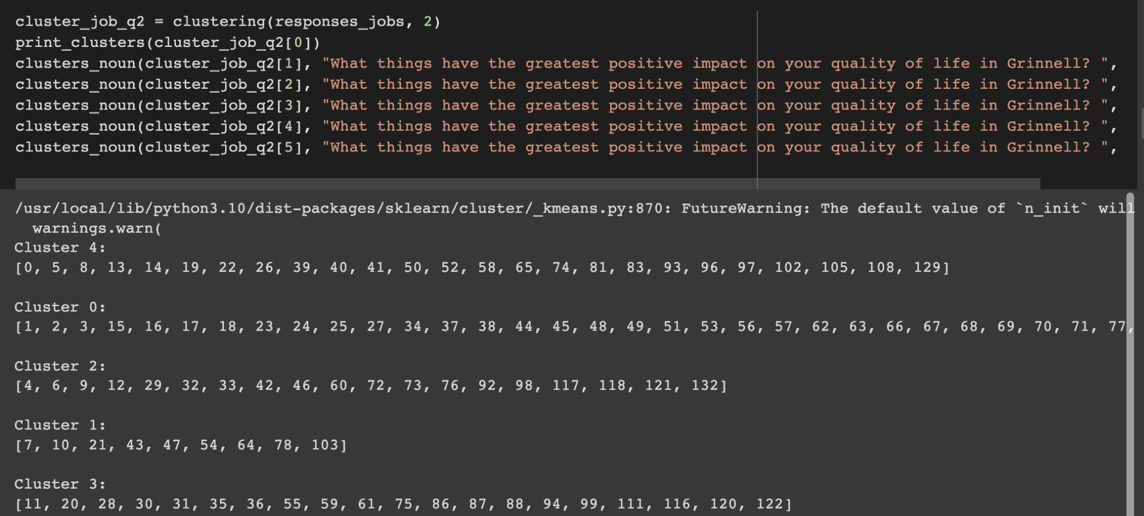

Slide 23
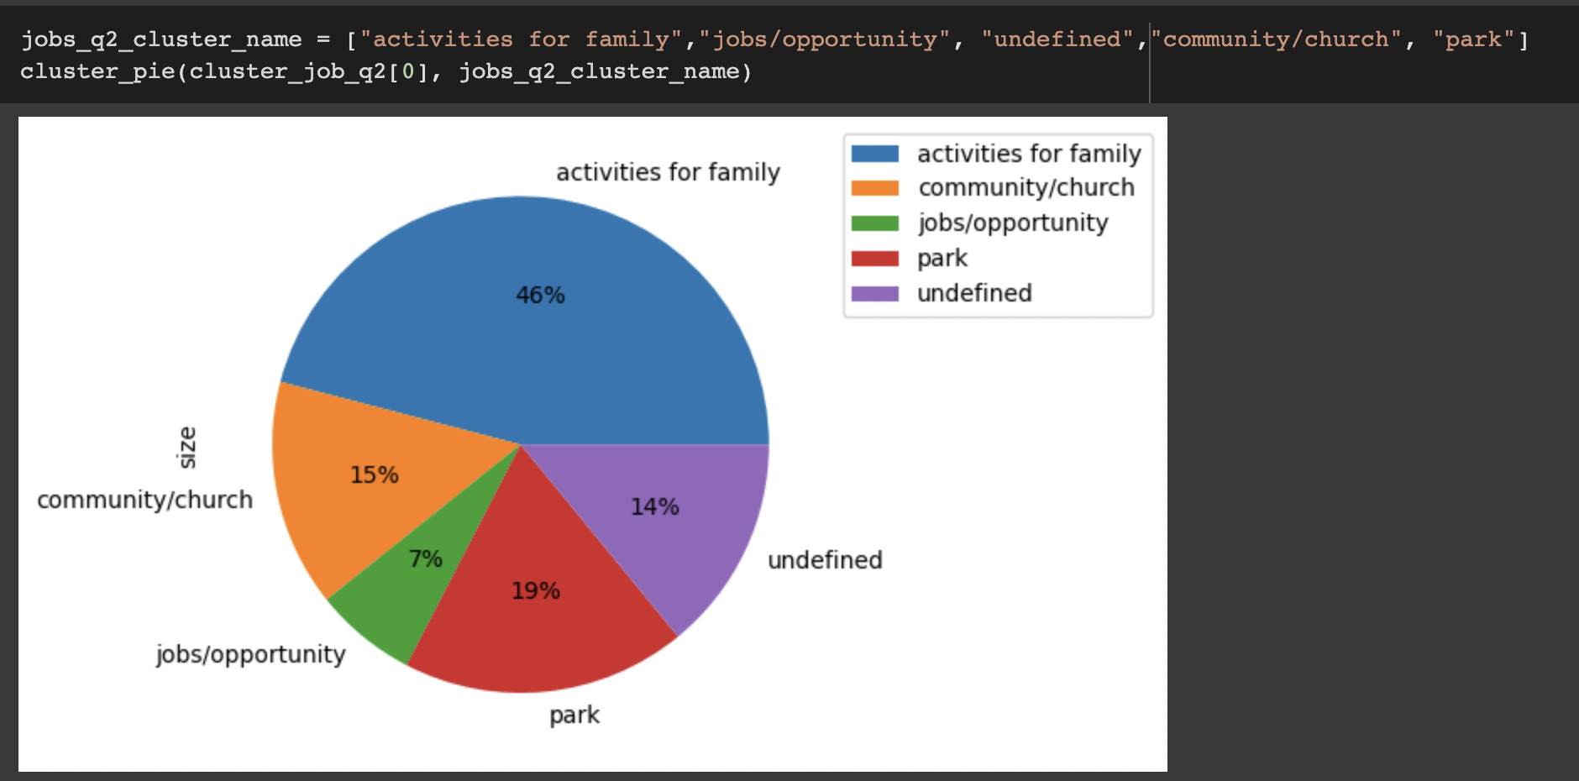

Slide 24
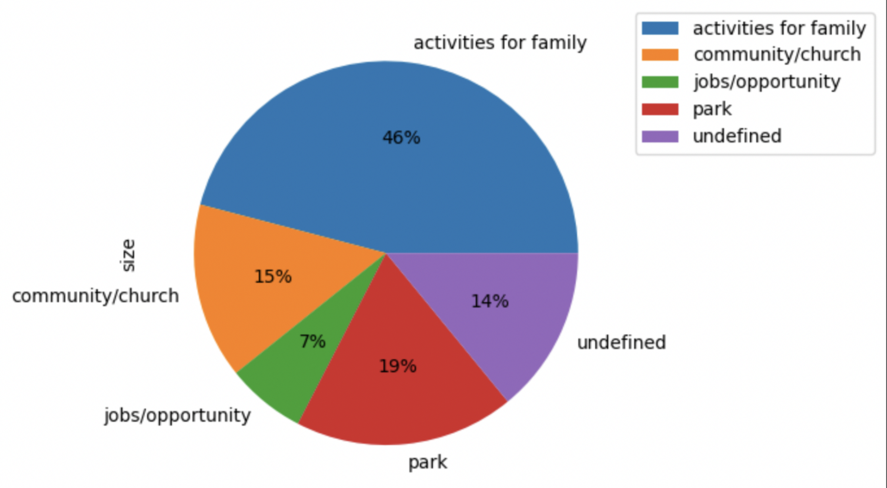
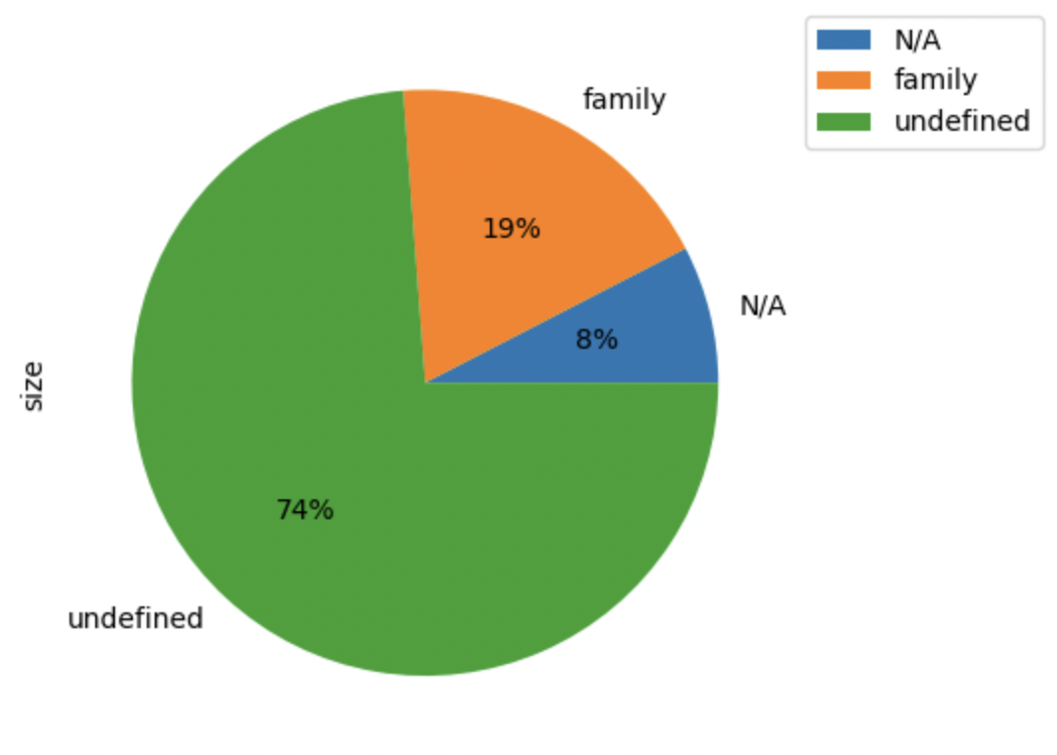
Issue: Jobs
Question 2: “What things have the greatest positive impact on your quality of life in Grinnell?”
Issue: Jobs
All strength questions
Pros: More comprehensive
Cons: Hard to define the common theme of each cluster
Pros: Distinctive clusters, Easy to supervise
Cons: Small Cluster Size

Slide 25
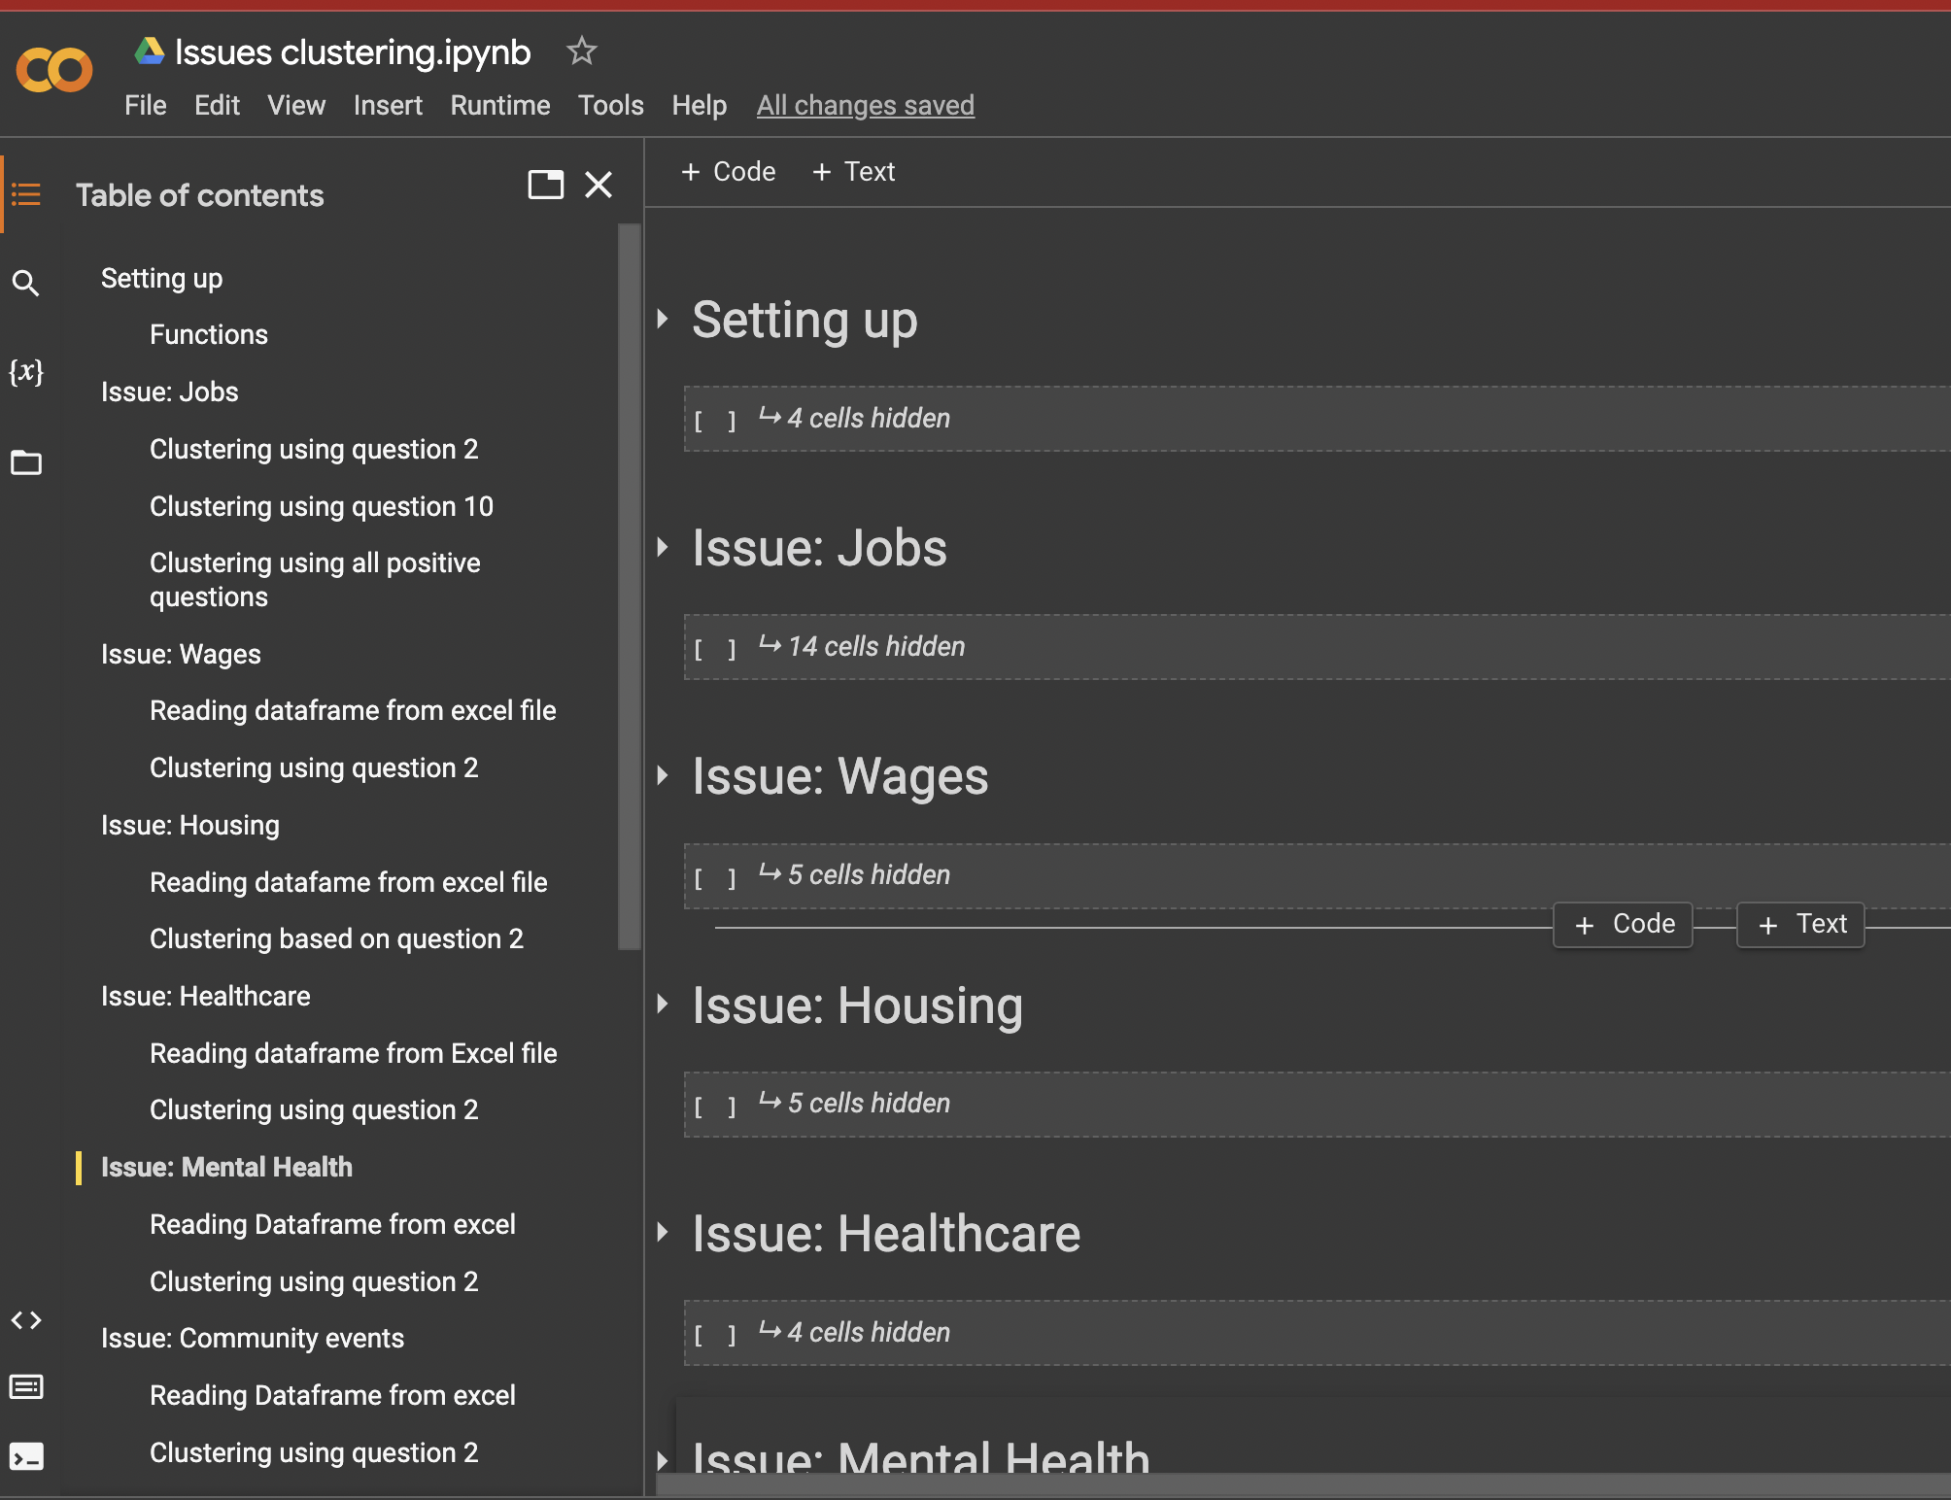
Goal 4: Repeat the analysis with the groups with counts that client has identified
Google Collab notebooks

Slide 26
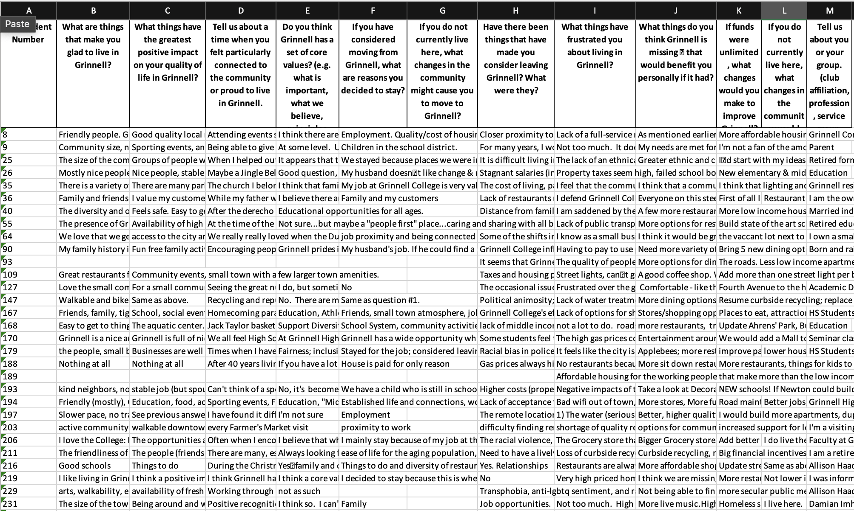
Subset for Higher Wages or Lower Prices

Slide 27
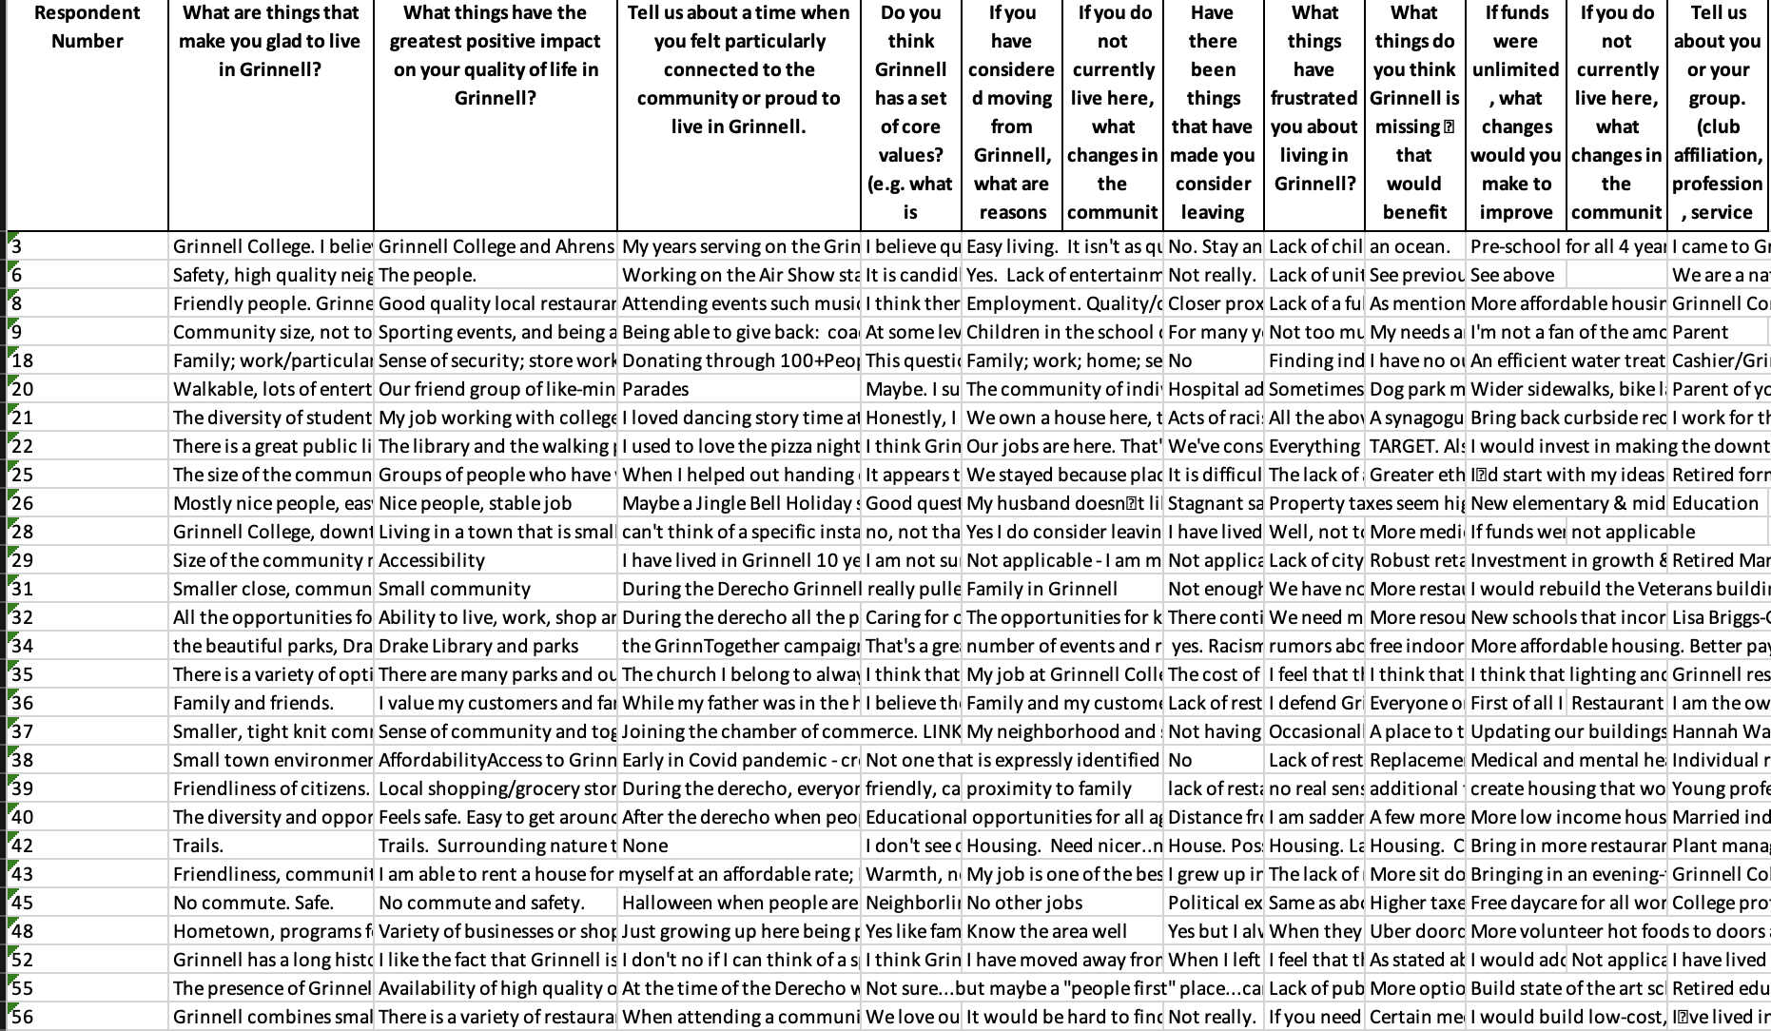
Subset for More Housing Options

Slide 28
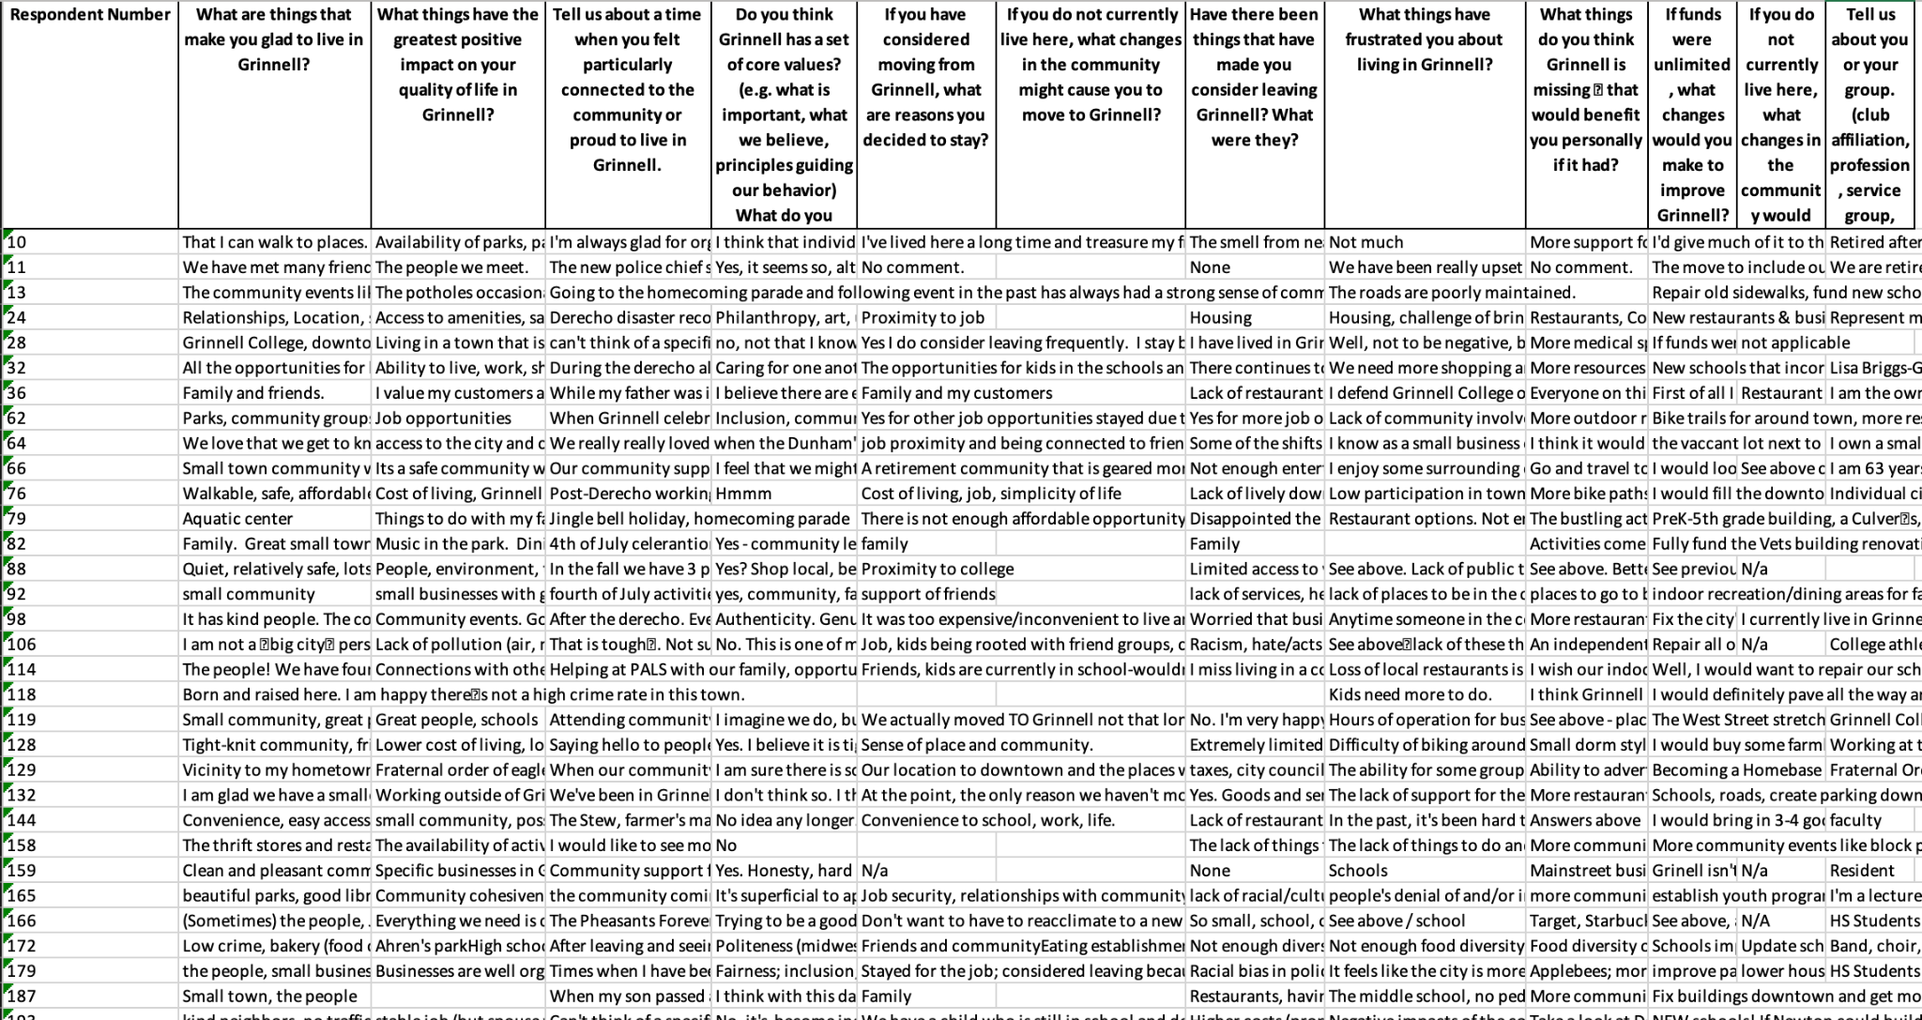
Subset for More Community Events

Slide 29
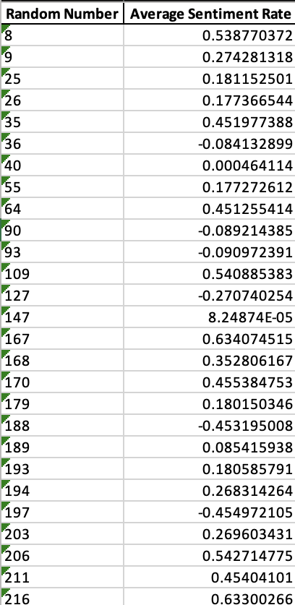
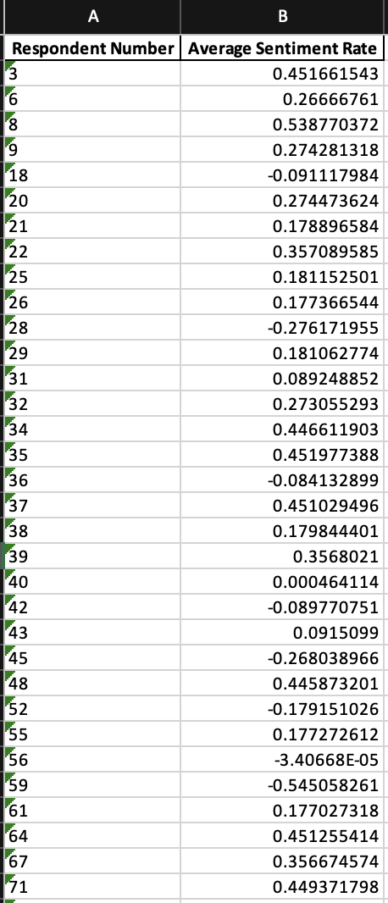
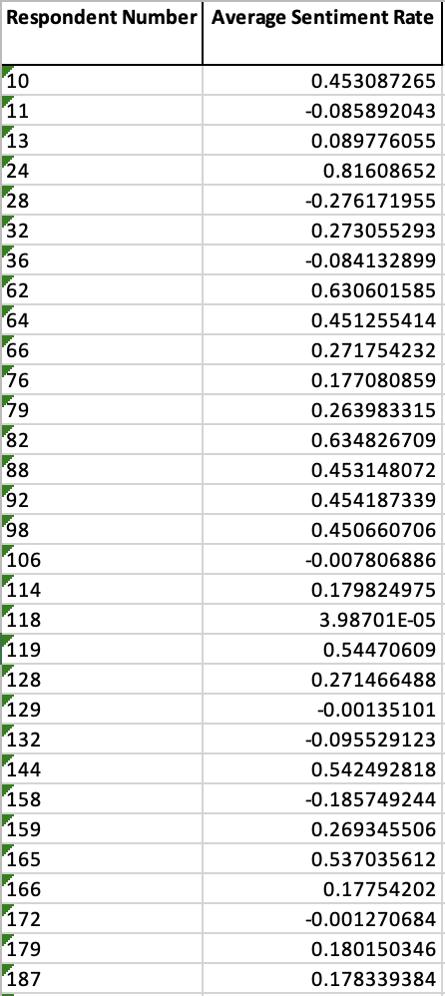
Wages
Housings
Community Events

Slide 30
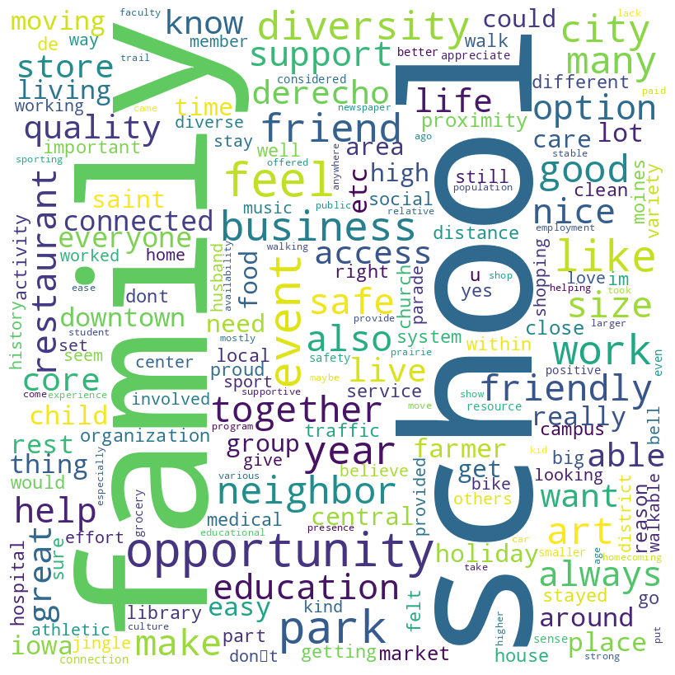
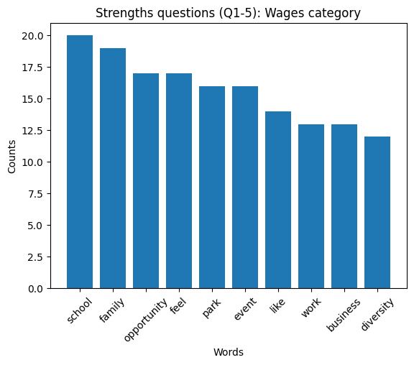
Higher Wages or Lower Prices

Slide 31
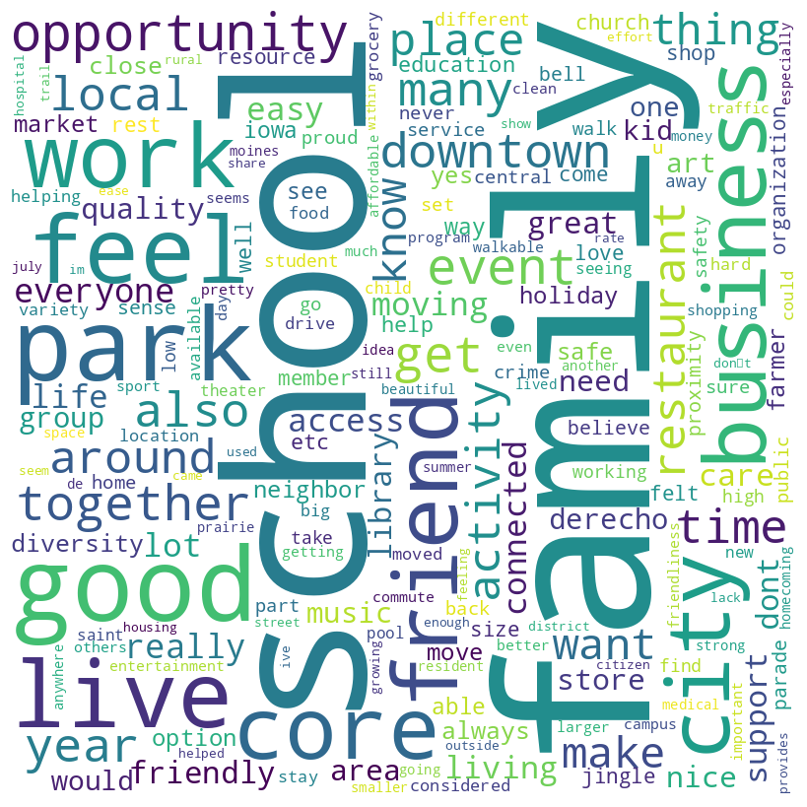
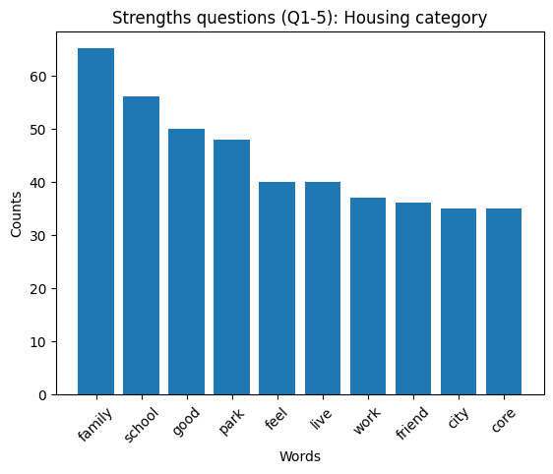
More Housing Options

Slide 32
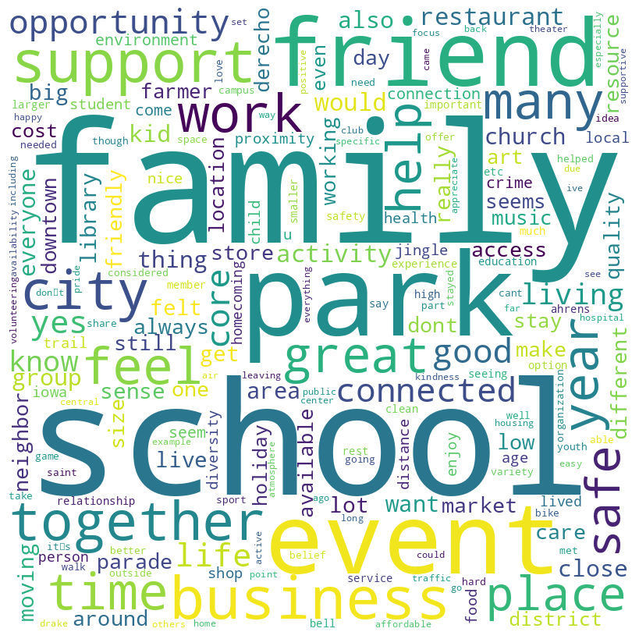
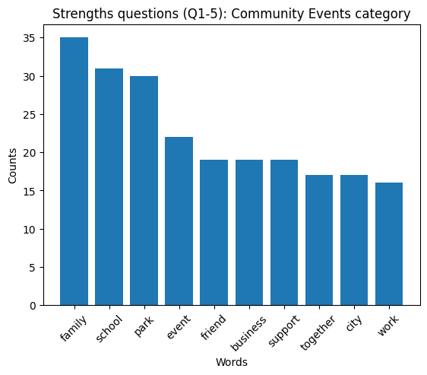
More Community Events

Slide 33
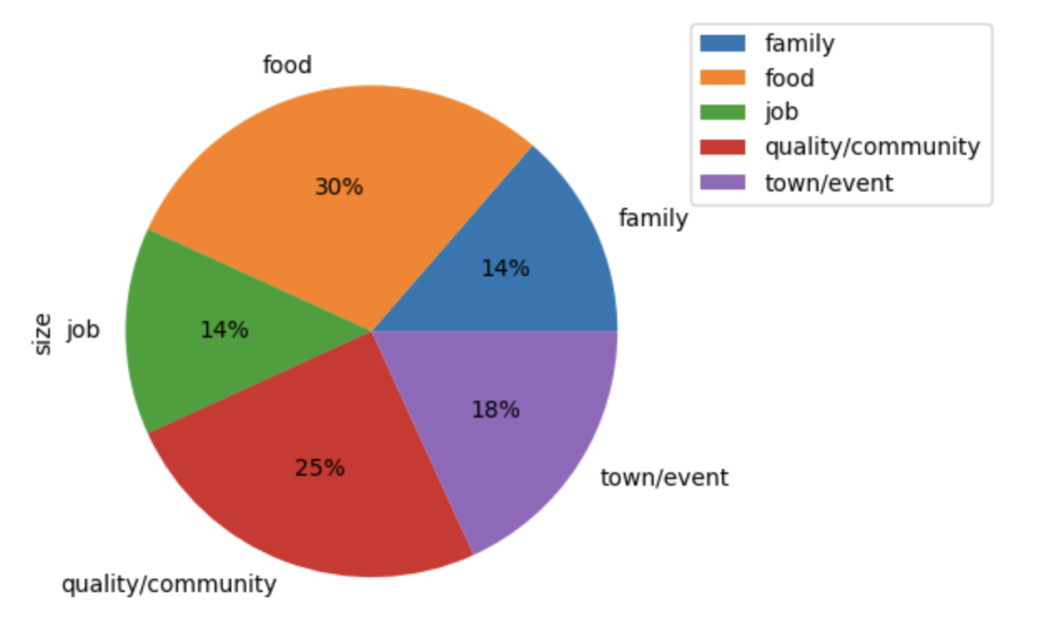
Issue: Higher Wages or Lower Prices
Keywords using: Wages, living wage, inflation, salaries, prices, cost of living, living expenses, income, social welfare
Question: What things have the greatest positive impact on your quality of life in Grinnell?
Keywords using: Wages, living wage, inflation, salaries, prices, cost of living, living expenses, income, social welfare

Slide 34
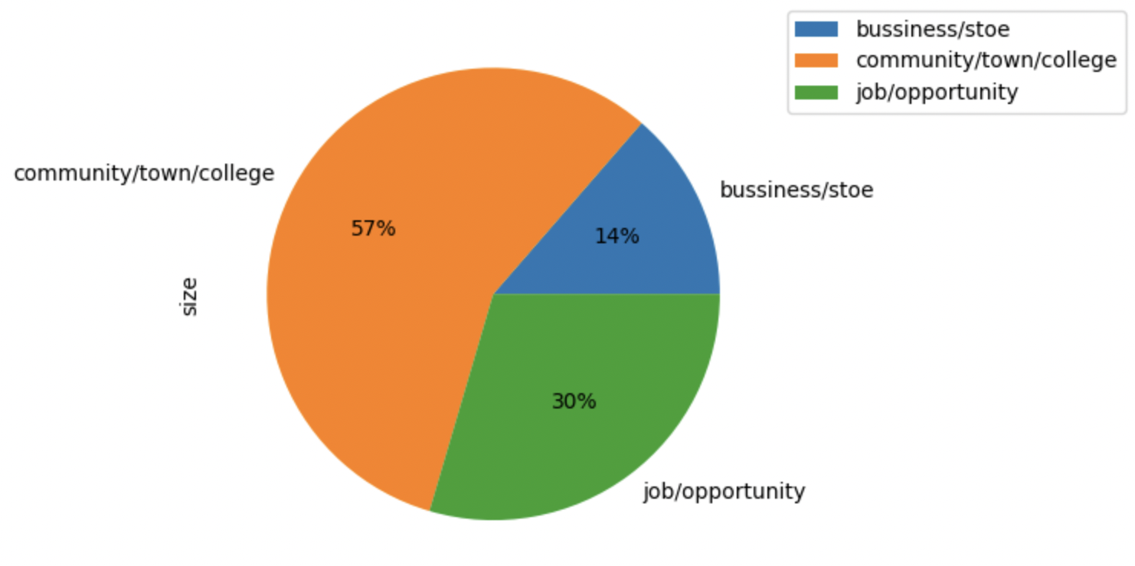
Issue: More Housing Options
Keywords using: House, housing, apartment, rentals, affordable, rent, lower rent, more housing options, accessible housing, off-campus housing, eco-housing, housing variety
Question: What things have the greatest positive impact on your quality of life in Grinnell?

Slide 35
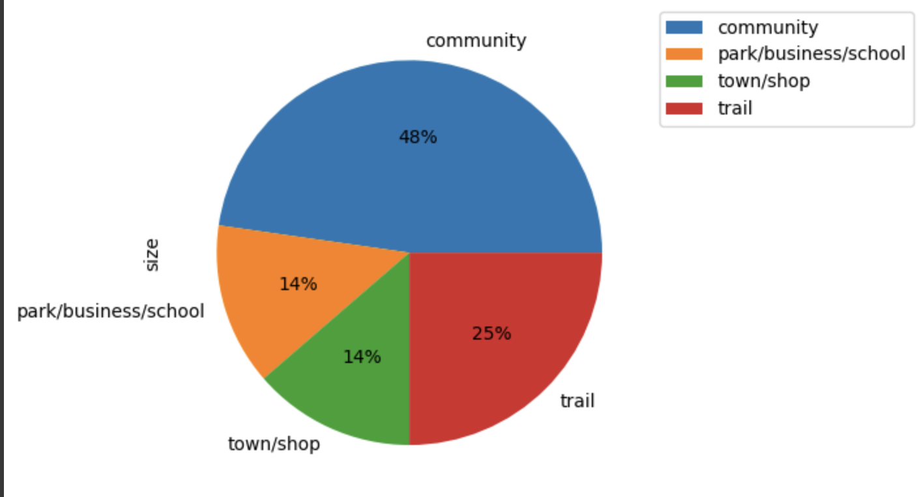
Issue: More Community Events
Keywords using: Events, art events, youth events, family events, sports event, art exhibitions, cultural events, central park events, community events, downtown events, harris events, festivals, food festivals, community meals, public talks, presentations, movies, outdoor movies, summer carnival, fall fests, friday fest, county fair, Farm to table events, gatherings, neighborhood gatherings, social gatherings, concerts, farmers markets, charity events, volunteering, volunteer opportunities, music festivals, parades. Evening coffees, extend, longer, prolong business hour
Question: What things have the greatest positive impact on your quality of life in Grinnell?

Slide 36

Reflections
Goal 1: Data Cleaning
Reapply data cleaning process on the new datasets clients provided
Goal 2: Create a keyword list and filter out respondents using these keywords
Supervised keyword list creating process
Goal 3: Subset these respondents, and then see what they are saying by clustering, word frequency, sentiment average, etc.
Subset the respondents based on keyword list and further analysis
Goal 4: Repeat the analysis with the issue groups with most counts that client has identified
Conduct for other issue groups

Slide 37
